Slide 1

SDV602
Environment Discussion
&
Game Story description

Slide 2
UNITY – Game Development Env
Cross platform game engine
Important features
All in one editor
2D & 3D
AI pathfinding tools
Efficient workflows
User interfaces
Physics Engine
Custom tools
Unity Interface
Scene view
Game view
Hierarchy Window
Project window
Inspector window
Toolbar
Button area
Miscellaneous Editor settings

Slide 3
Scripting in Unity
Way to communicate with Game Objects
It tell game objects
How to behave
How to interact
Scripting in unity is different from normal pure programming.
Unlike pure programming Unity itself runs the application.
Developer just need to focus on the gameplay in scripts.
Script must be attached with Game Object
Scripts supported by Unity
C# - best choice
JavaScript - alternative
Boo – Old choice
Iron Python – odd choice
Lua – Interesting choice
C/C++ - For plugins
Rust – For plugins
Parts of a Script – using C#
Variables
Functions
Classes
In-built functionalities
Start
Update
Awake

Slide 4
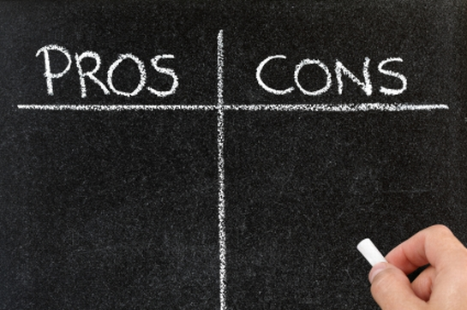
Cross platform development
Effective for 2D rendering
Great asset store
Easy to use interface
Less expensive
Large availability of tutorials
Lot of the facilities provided by other engines are still in development stage
High memory consumption
Out of date documentation
Free features of other engines are not available here without paying
Need extra license for pro mobile

Slide 5
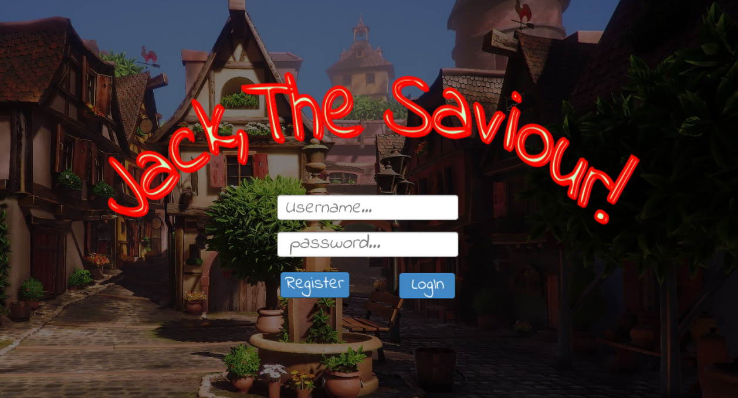
Jack, The Savior!

Slide 6
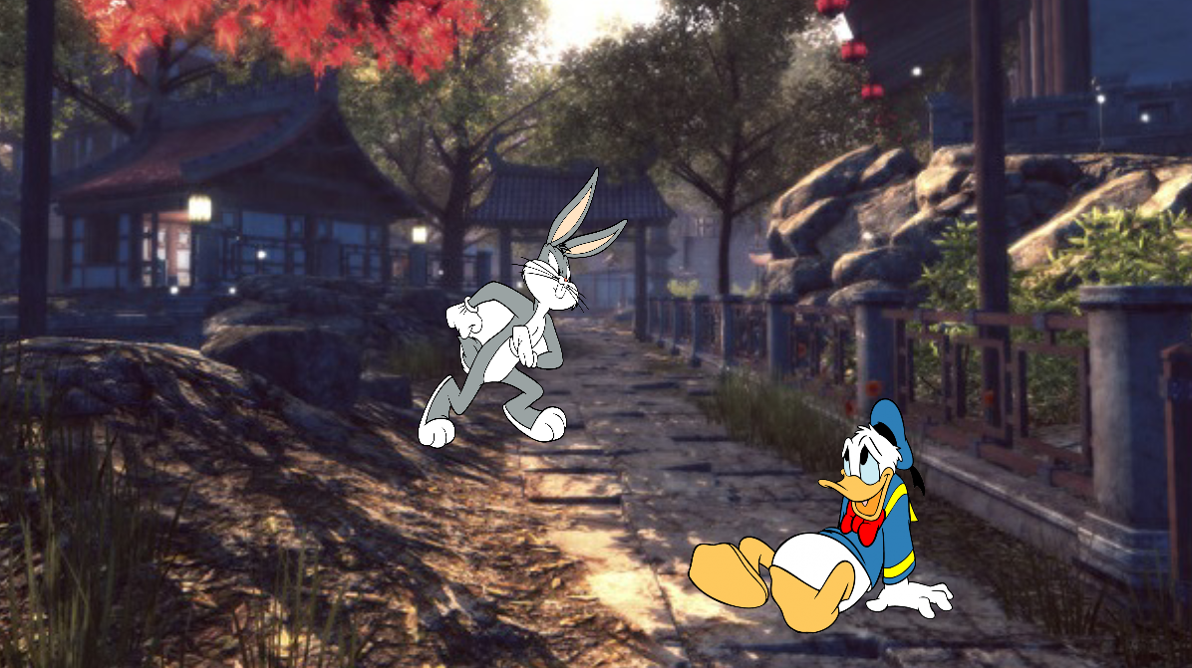
Jack, The Savior!
The basic theme of the game is
Jack is a bunny
His parents were caught by a monster when they went to the forest in search of food
Jack need to enter the castle in-order to save his parents from monster
He needs to pass all levels where he must answer multiple questions
Once he pass all levels Jack can enter the castle and his parents will be freed.
Text-Based game
Game play based on input given by the player
Player needs an account to play the game
Can join a random game or start a new game
Game starts with 10 hearts and a timer will be running
Each wrong answer deducts hearts by 2 and game will be over when it reaches 0

Slide 7
Thank You

